Slide 1
IDENTITY THEFT: PROTECTING PERSONAL IDENTIFIABLE INFORMATION (PII) PREPARED FOR PROFESSOR TYSON BROOKS IST 623, INTRODUCTION TO INFORMATION SECURITY DECEMBER 3, 2020
PREPARED BY:
AMANDA AUSTIN
CHRISTOPHER HART
DAVID LADD

Slide 2
Agenda
Narrative Case Study: Introduction
What is Identity Theft?
Data Exploration from Victims of Identity Theft National Surveys
Narrative Case Study: Practical Preventative Actions
The Dark Web
Narrative Case Study: Effects of Identity Theft
Narrative Case Study: Key Lessons
Questions and Wrap Up

Slide 3
Narrative Case Study: Introduction
In August 2018, received a call from a detective of the Cobb County Sheriff’s Department.
Asked some questions to confirm my identity, then explained my identity was stolen.
A neighbor received cell phone deliveries from Verizon. Packages were under my name. She called the police.
After the perps went to her house to retrieve the phones, they were stopped by the police, but not arrested.
Investigation revealed that the perps obtained my SSN and DOB.
SSN, DOB, and neighbors address used to open multiple cell phone accounts with Verizon and T-Mobile.
SSN and DOB with another physical address to obtain a State of Georgia non-driver identification card.
Opened utility accounts using the other physical address and State ID card.

Slide 4
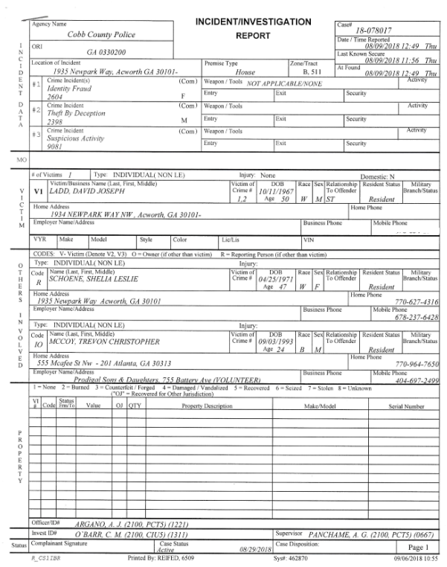
Cobb County Police Report
Notes:
Explain police report and point out the address used by the perps.

Slide 5
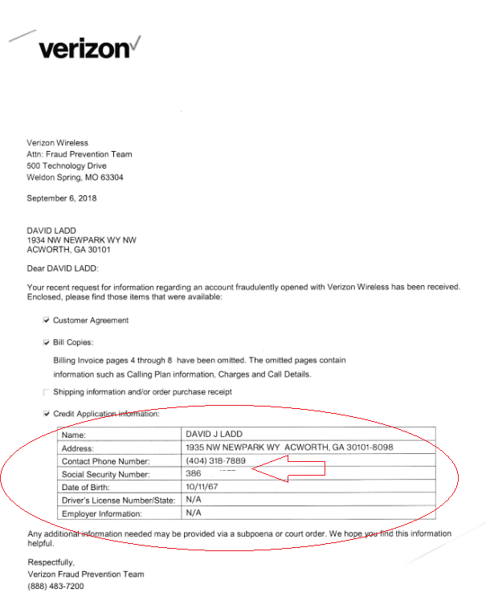
Letter from Verizon Fraud Department
Notes:
Highlight the use of social security number, an unknown cell phone number and my neighbors address.

Slide 6
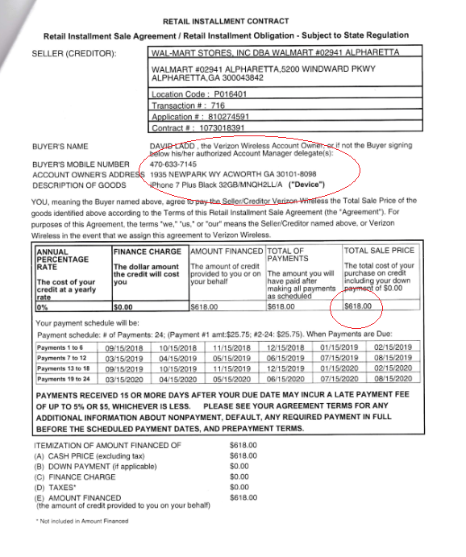
Verizon Contract
Notes:
Highlight the use of social security number, an unknown cell phone number and my neighbors address.
Perps attempted to open 4 accounts at Wal-Mart on that day.
Amounts varied, but the grand total was over $2,700.00

Slide 7
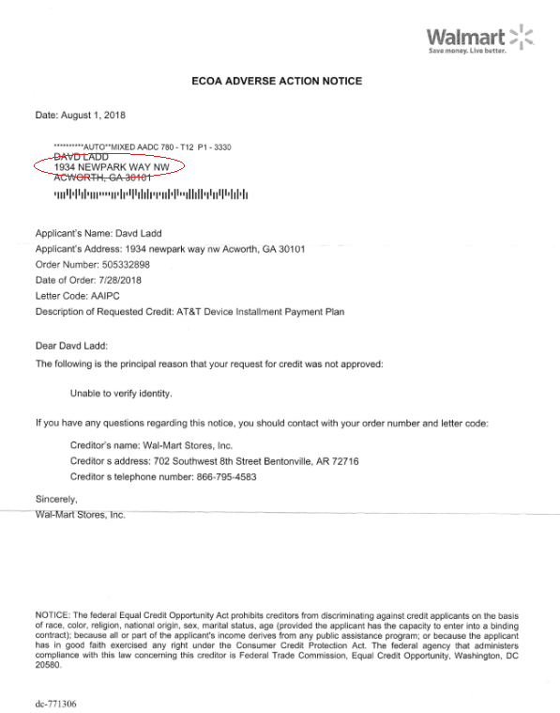
Verizon Adverse Action Notice
Notes:
Received this letter in the mail prior to the Cobb County Police calling me.
Interesting point is Wal-Mart sent the letter to my correct address even though the credit applications used the 1935 Newpark address.

Slide 8
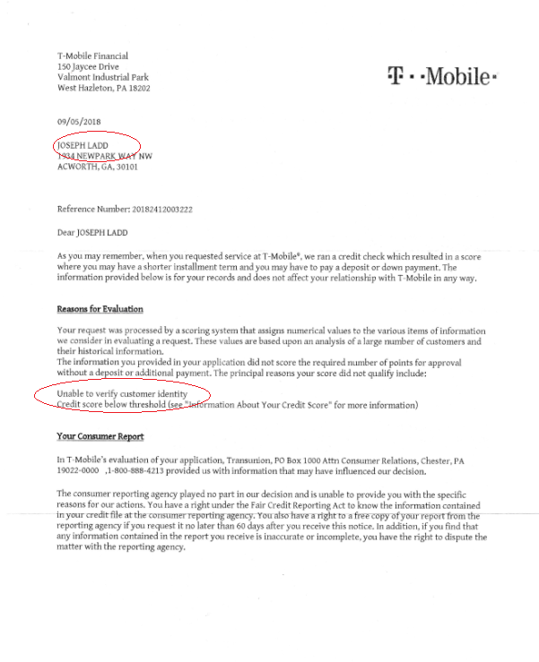
T-Mobile Adverse Action Letter
Notes:
Received this letter after notification from Cobb County Police.
With T-Mobile, the perps used my middle name and omitted my first name.
Credit was not established under “Joseph”
In addition to Verizon and T-Mobile, the perps opened utility accounts, and applied for a Georgia State Identification card.

Slide 9
What is Identity Theft?
Identity theft can refer to multiple types of crime in which someone wrongfully obtains and uses another person's personal data in some way that involves fraud or deception, typically for economic gain (U.S. Department of Justice, 2017).
The four types of identity theft include: medical, criminal, financial, and child identity theft (The F.A. Peabody Company, 2020).
The National Crime Victimization Survey (NCVS) is the nation's primary source of information on criminal victimization. Survey data tables published in 2019 report 2016 experiences with identity theft with specific attention to three general types of incidents::
Unauthorized use or attempted use of an existing account
Unauthorized use or attempted use of personal information to open a new account
Misuse of personal information for a fraudulent purpose.
Notes:
From the introduction of David’s narrative case study, Beyond asking about his personal welfare, we had a genuine curiosity about the origins of identity theft, the impact it had on victims, and where responsibility for preventative measures should fall.
The U.S Department of Justice defines identity theft and fraud as terms used to refer to all types of crime in which someone wrongfully obtains and uses another person's personal data in some way that involves fraud or deception, typically for economic gain.
There are four named types of identity theft include medical, criminal, financial and child identity theft.
Medical identity theft occurs when an individual identifies themselves as another to procure free medical care.
Criminal identity theft generally takes place when one identifies themselves as someone else during an arrest to avoid a summons, detection of a warrant in their real name or to evade an actual arrest or conviction.
Financial identity theft is the most common. It occurs when someone uses another person’s information to attain goods, services or information.
Child identity theft is common among those who know the child and understand that the child is unlikely to discover identity theft. It may be used to gain employment or a residence.
The Bureau of Justice Statistics under the DOJ administers the National Crime Victimization Survey (NCVS) is the nation's primary source of information on criminal victimization. Each year, data are obtained from a nationally representative sample of about 240,000 interviews on criminal victimization, involving 160,000 unique persons in about 95,000 households. Persons are interviewed on the frequency, characteristics, and consequences of criminal victimization in the United States.
Within the NCVS we can isolate data examining identity theft victimization at the person level. The survey data tables made available in 2019 report 2016 experiences with identity theft with specific attention to three general types of incidents:
Unauthorized use or attempted use of an existing account
Unauthorized use or attempted use of personal information to open a new account
Misuse of personal information for a fraudulent purpose.

Slide 10
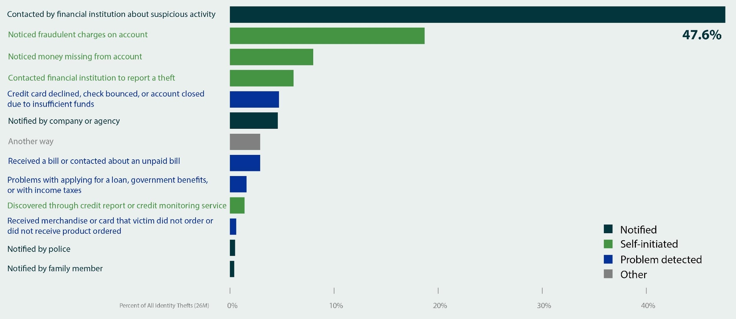
Common Ways Victims Discover Identity Theft (NCVS, 2016 Identity Theft Supplement (ITS))
Source: U.S. Department of Justice, Office of Justice Programs, Bureau of Justice Statistics. Victims of Identity Theft from the National Crime Victimization Survey (NCVS). January 2019, NCJ 251147.
Notes:
Our data exploration initiated with an examination of a three inquiries from the 2016 Identity Theft Supplement. This supplement, administered from January 1-June 30 2016 to NCVS households that were interviewed (134,690), was answered by approximately 125,200 persons age 16 or older.
First, we wanted to better understand some common ways that victims discovered that their identity had been stolen. In doing so, we might better recognize the origins of identity theft.
Nearly half (48%) of identity theft victims discovered their most recent incident when notified by a financial institution about suspicious account activity. 19% actually noticed fraudulent charges on their own. While this initial data distribution supports the commonality of financial identity theft, of interest to us was the central role financial institutions and self-monitoring appear to play in detecting and potentially addressing identity theft. Much less significant was any role products such as credit monitoring appear to play in detection or prevention.

Slide 11
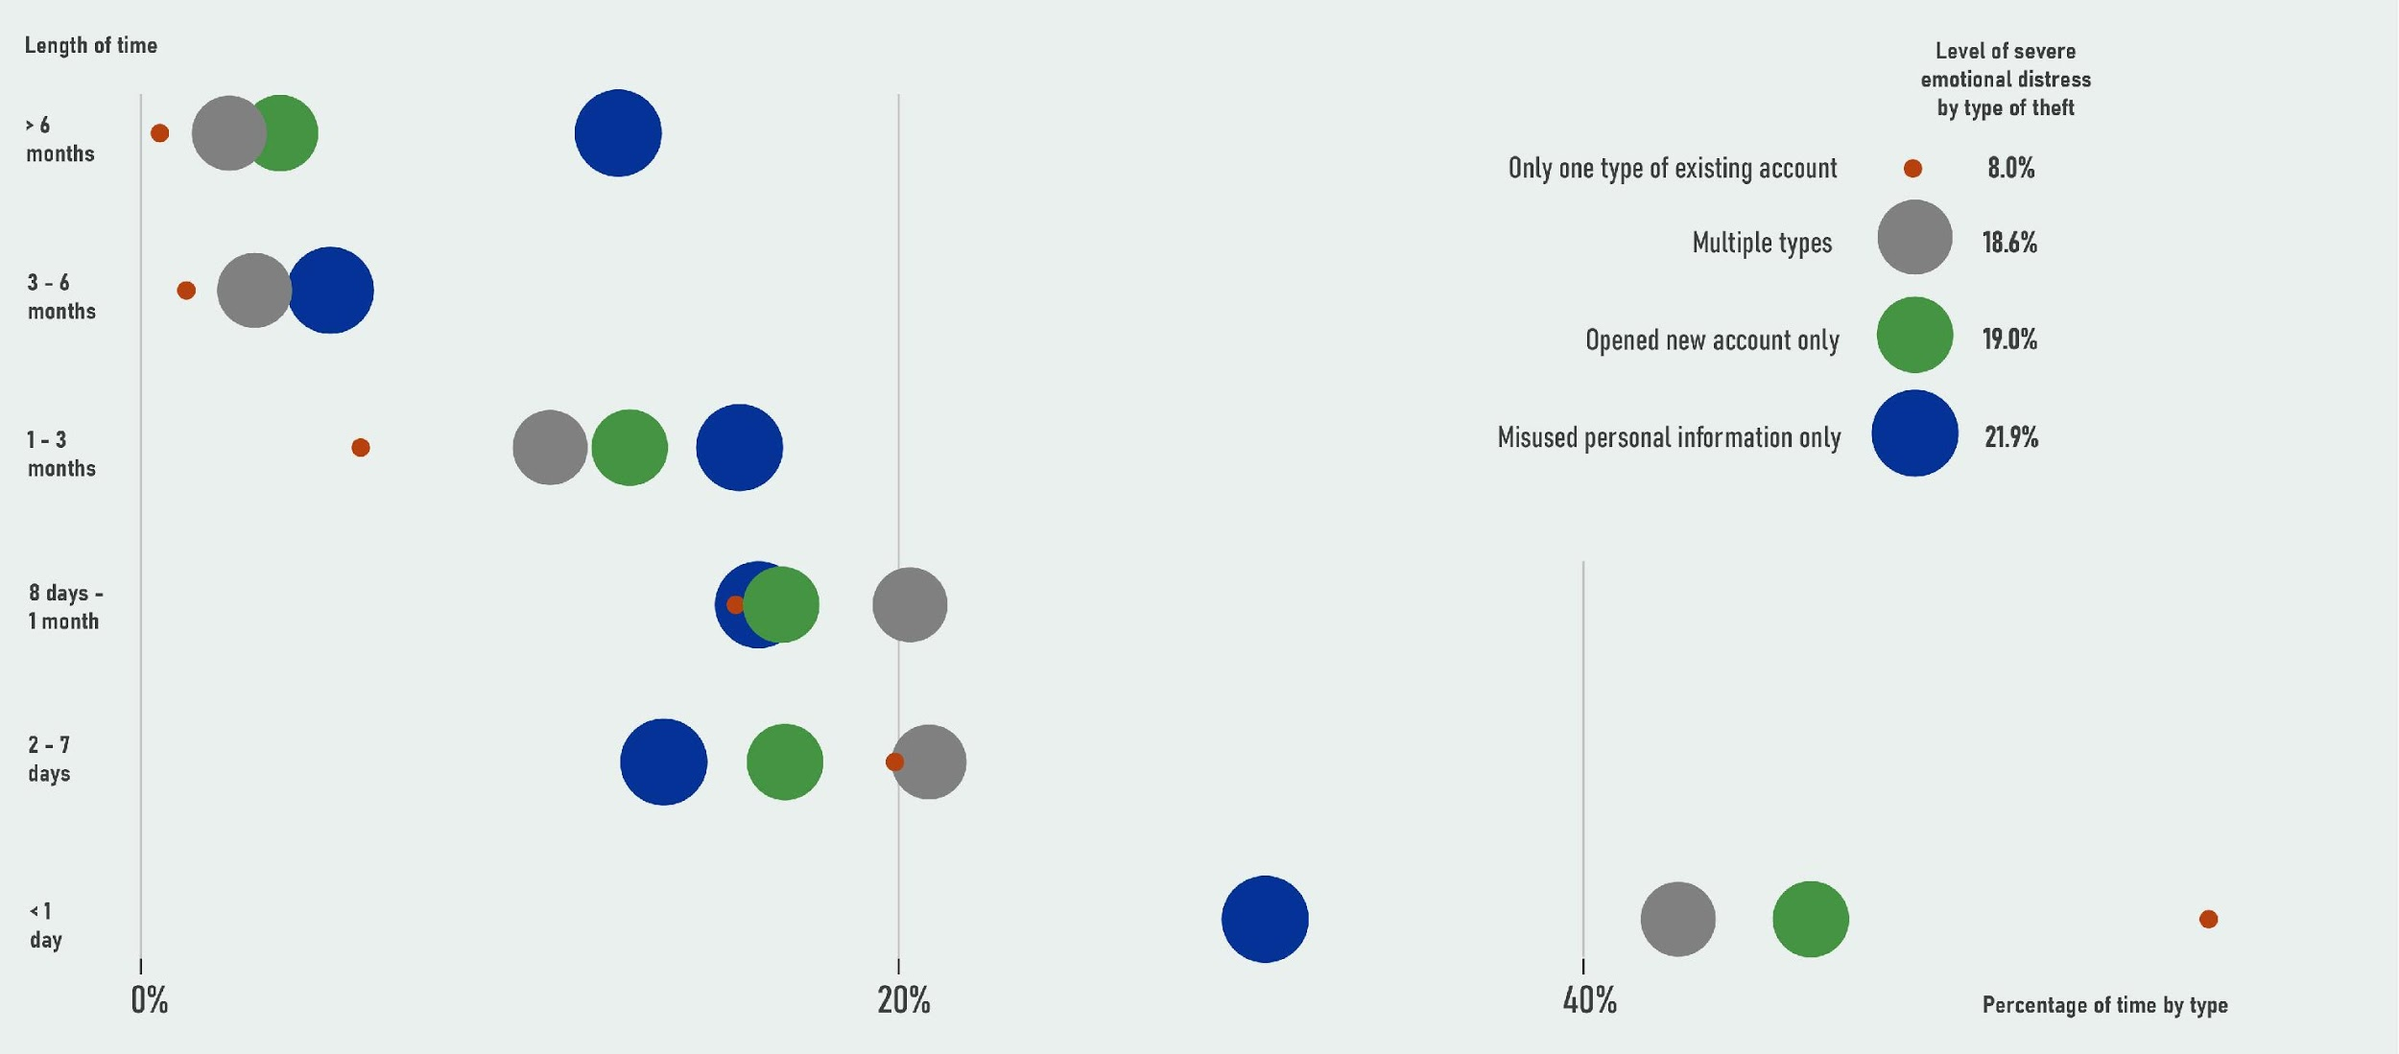
Theft Resolution and Emotional Distress (NCVS, 2016 Identity Theft Supplement (ITS))
Source: U.S. Department of Justice, Office of Justice Programs, Bureau of Justice Statistics. Victims of Identity Theft from the National Crime Victimization Survey (NCVS). January 2019, NCJ 251147.
Notes:
Our second area of exploration looked at the impact it had on victims, as introduced by David. This data visualization actually combined two distinct survey datasets looking at the length of time spent resolving financial and credit problems associated with identity theft in relation to the percentage of persons who experienced severe emotional theft indicated by the type of theft.
The colors represent the 4 types of theft identified in the survey and the size indicates the percentage of persons that experienced severe emotional stress when dealing with each type with “Misuse of personal information only” being the most stressful. The plot shows the amount of time spent resolving each type of identity theft.
Overall, 36% of victims who spent 6 months or more resolving financial and credit problems experienced severe emotional distress. This is in comparison to on 4% of victims who spent one day or less.
On average, victims spent just 4 hours clearing up issues but had a heavy toll on those who were outside the norm.

Slide 12
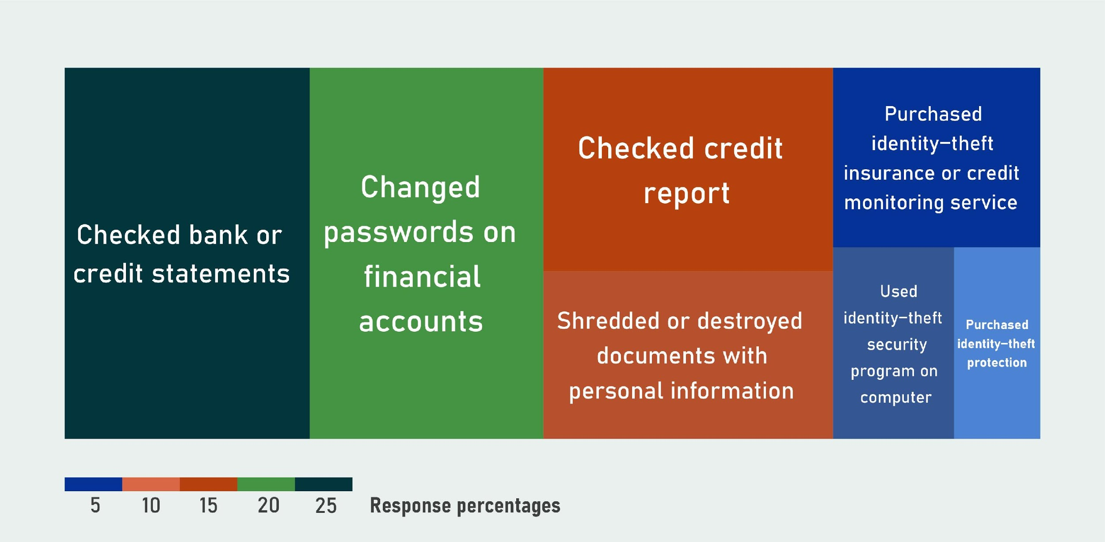
Response Action from Victims (NCVS, 2016 Identity Theft Supplement (ITS))
Source: U.S. Department of Justice, Office of Justice Programs, Bureau of Justice Statistics. Victims of Identity Theft from the National Crime Victimization Survey (NCVS). January 2019, NCJ 251147.
Notes:
Finally, we used a reporting data table to create a high-level tree map showing the actions that had been taken during the past 12 months to reduce the risk of identity theft. Among those who experienced an identity theft, the most common preventative action taken was regularly checking bank and credit card statements (25.9%) and changing passwords on financial accounts (24.7%). Of interest, only 6.6% used identity-theft security on computers which compares to just 16.2% of the total survey population.
Returning to our case study, David can share the practical actions he took in response to an identity theft.

Slide 13
Narrative Case Study: Corrective and Preventive Actions
Immediate Corrective Actions
Notified the FTC and was registered as identity theft victim
Put a freeze on my credit with all three credit bureaus
Also notified the Consumer Financial Protection Bureau
Established Credit Karma account to monitor credit activity
Long Term Preventive Actions
Shred or burn mail instead of throwing into trash
Cut or peel off shipping labels from packages and shred
Closed traditional bank accounts and opened an investment account with cash management features (Bill pay, debit card, credit card, etc.)
After moving from Georgia, I notified each organization within my network of the address change. (Did not file a change of address with the post office)
Stopped answering phone calls from unknown numbers (Legitimate callers leave voicemails)
Reduced the number of email accounts
Keep track of expected mail deliveries that may contain PII (prescriptions, tax documents, bank statements, etc)
Notes:
David

Slide 14
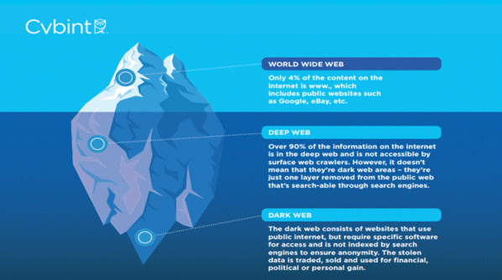
Layers of the Web
World Wide Web (Surface Web)
Collection of Web Sites, indexed by search engines (i.e Google) using web crawlers to search, find, and categorize information
Easily accessed through standard browsers and Internet protocols
Deep Web
Estimated to be 4000-5000 times larger than the Surface Web (over 90% of traffic)
Not accessible via search engines/surface web crawlers
Dark Web
Small, difficult to access portion of the Deep Web
Less than 0.01% of the Internet (~45K total sites)
Anonymous and largely unregulated by the government
Retrieved from: secureworldexpo.com/industry-news/dark-web-vs-deep-web 11/8/2020
Notes:
Transition:
Even with continuous protection, PII can never be 100% secure and can get into the wrong hands.
One of them more mysterious and lesser-known side effects of ID Theft is the Dark Web
General public awareness of the Dark Web and having a high-level understanding of the activity that occurs on the Dark Web will allow individuals to better understand how to protect themselves
Surface Web
Smallest part of the Web
Everyday Web surfing & sites
Deep Web
Companies, web developers, and websites tell search engines like Google to not search for or categorize this information (will not come up from a web search)
CAN be accessed through Surface web applications (Greenberg 2014)
Application program interfaces (API) I.e. Data from sites like FB, Twitter, or Snapchat (Twitter API in Data Science Program)
Instant messaging data
File-sharing services such as Dropbox and Google Drive
Direct web address – type into browser
Dark Web
Cannot be accessed through the Surface Web - instead, must be accessed through a special browser or software which may or may not require a password
Still uses public Internet
Not indexed by search engines (ensures anonymity)
***Dark Web versus Deep Web distinction: Ability to access via Surface Web

Slide 15
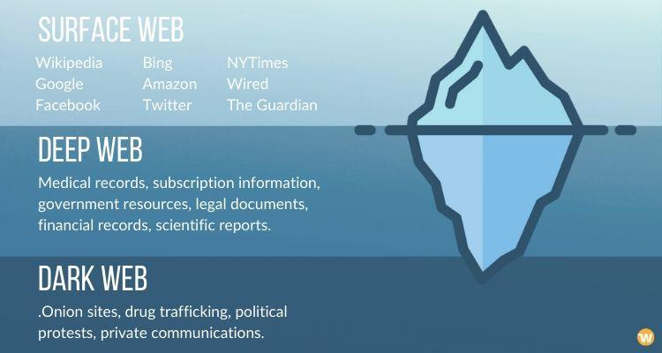
Layers of the Web – Examples
Retrieved from: https://www.webhostingsecretrevealed.net/blog/web-tools/tourist-guide-to-dark-web-accessing-the-dark-web-tor-browser-and-onion-websites 11/8/2020

Slide 16
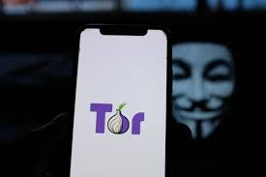
The Onion Router (Tor)
Creation:
Developed by the Naval Research Laboratory to provide a secure and anonymous means for US military personnel to communicate abroad
Layers of encryption make it very difficult to determine the requestor's IP address
In October of 2003, the NRL deployed it as a free, open-source browser - allowing military traffic to be hidden within civilian users
Benefits:
Anonymous Web browsing
Deep Web research
‘There are important uses for hidden services, such as when human rights activists use them to access Facebook or to blog anonymously.’
-Roger Dingledine, original developer of Tor
Retrieved from: https://edgy.app/top-5-dark-web-browsers 11/29/2020
Notes:
Encryption:
Site requests travel between at least 3 computers, which each computer adding another layer of encryption to the message.
Can only be decrypted by the computer that encrypted
Randomization of algorithms ensures encryption cannot be cracked
Not always for illegal purposes:
Users wanting to Browse Surface Web anonymously
Country of residence does not have free & open access to the Internet
Concerns about privacy
Quote

Slide 17
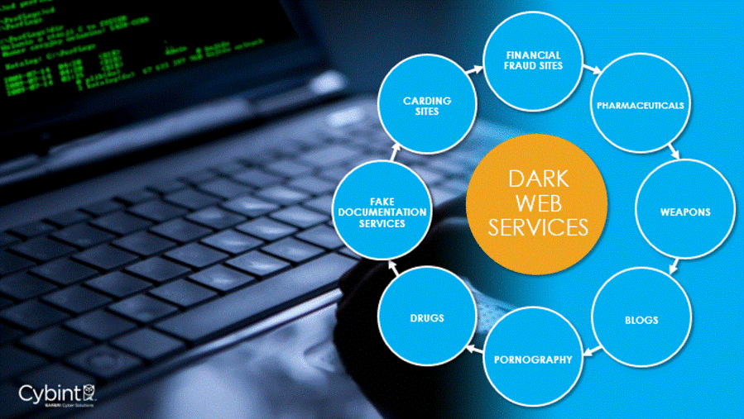
The Dark Web for Criminal Purposes
“The stolen data is traded, sold, and used for financial, political, or personal gain.” (Chertoff)
Illegal markets
Social Security Numbers
Stolen account info
r/darknetmarkets
Fake Documents
Government Intervention
Balancing privacy and safety
Laws keeping up with technology
Specific policy
Retrieved from: secureworldexpo.com/industry-news/dark-web-vs-deep-web 11/8/2020
Notes:
What do Identity thieves do with PII?
Where do social security numbers and other sensitive info go once obtained?
Illegal markets:
Stolen account info (credit card numbers and PayPal account info)
r/darknetmarkets – Reddit forum where users discuss illegal online marketplaces
Fake IDs, fake passports, and other fake documents (possibly from stolen SSNs)
Government intervention and policies surrounding the Dark Web: Won’t get into here, but it’s a highly-debated topic.
Transition: Huge market for PII on the Dark Web, which could have a huge toll on identity theft victims.

Slide 18
Narrative Case Study: Effects of Identity Theft
Effects are long term
Credit scores suffered for a long period of time
Feels like a violation and causes emotional distress
Excessive worry about it happening again
Loss of time and expense
Fear of what else might lurk around the corner
PII is probably on the dark web
Notes:
Discuss the long term effect with filing taxes
Discuss issues with securing a NY driver’s license
Mention emails and phone calls that indicate dark web activity

Slide 19
Narrative Case Study: Key Lessons
Lessons from a narrative case study:
Personal Identifiable Information (PII) is at risk for identity theft and fraud in multiple locations and channels ranging from online services to common transactional documents.
Identity theft has both a financial and emotional cost which may last for an extended period of time before resolution.
There is a sophisticated dark web marketplace that facilitates the sale of personal information out-of-sight from the majority of individuals working and living in the U.S.
Prevention methods are varied, require dedicated attention, and active collaboration with organizations that handle personal data.
Notes:
In the year in which we analyzed data (2016), an estimated 26 million persons or about 10% of all U.S. residents age 16 or older, reported that they had been victims of identity theft during the prior 12 months. Of those with known loses greater than $1, total losses across all incidents of identity theft totaled $17.5 billion in 2016.
By examining a narrative case study, we can extract some practical lessons:
Personal Identifiable Information (PII) is at risk for identity theft and fraud in multiple locations and channels ranging from online services to common transactional documents.
Identity theft has both a financial and emotional cost which may last for an extended period of time before resolution.
There is a sophisticated dark web marketplace that facilitates the sale of personal information out-of-sight from the majority of individuals working and living in the U.S.
Prevention methods are varied, require dedicated attention, and active collaboration with organizations that handle personal data.

Slide 20

Questions?

Slide 21
Bibliography
DOJ Bureau of Justice Statistics. (2013). Bureau of Justice Statistics (BJS) - Identity Theft. Bjs.Gov. https://www.bjs.gov/index.cfm?ty=tp&tid=42
Michael Chertoff (2017) A public policy perspective of the Dark Web, Journal of Cyber Policy, 2:1, 26-38, DOI: 10.1080/23738871.2017.1298643
“The Four Types Of Identity Theft.” F.A. Peabody, 11 Apr. 2018, www.fapeabody.com/articles_and_videos/personal-finance/four-types-identity-theft/#:~:text=The%20information%20is%20captured%20in. Accessed 29 Nov. 2020.
US Department of Justice. (2017, February 7). Identity Theft. Justice.Gov. https://www.justice.gov/criminal-fraud/identity-theft/identity-theft-and-identity-fraud
‌

